Slide 1
Photo Classification
B02902012林子翔
B02902015梁智泓
B02902080 郭傳駿

Slide 2
Outline
Goal
In/Outdoor
Building
People
Evaluation
Demo

Slide 3
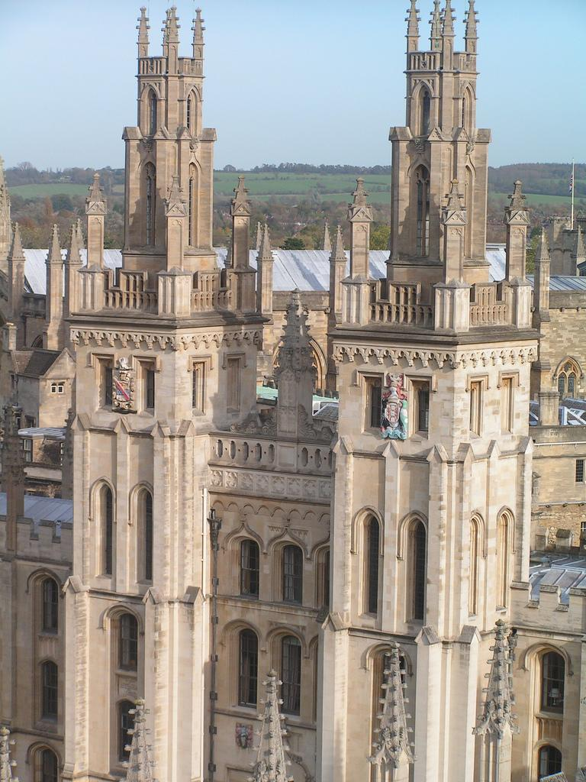
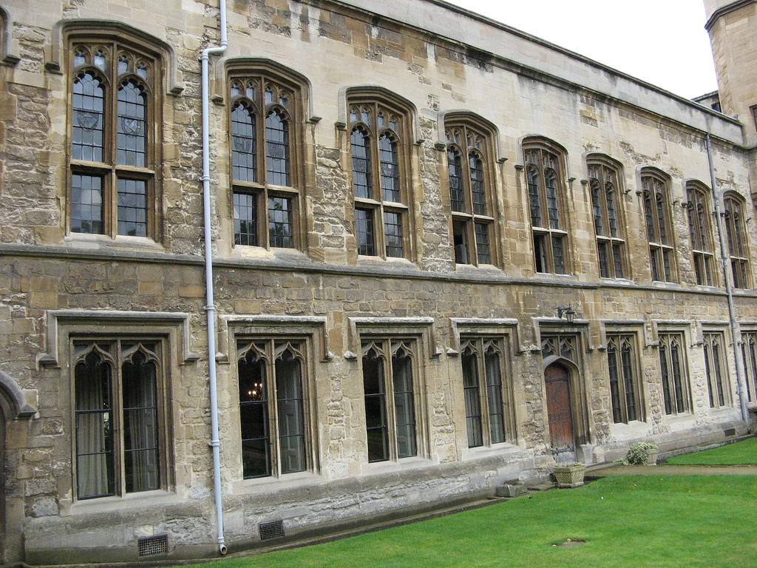
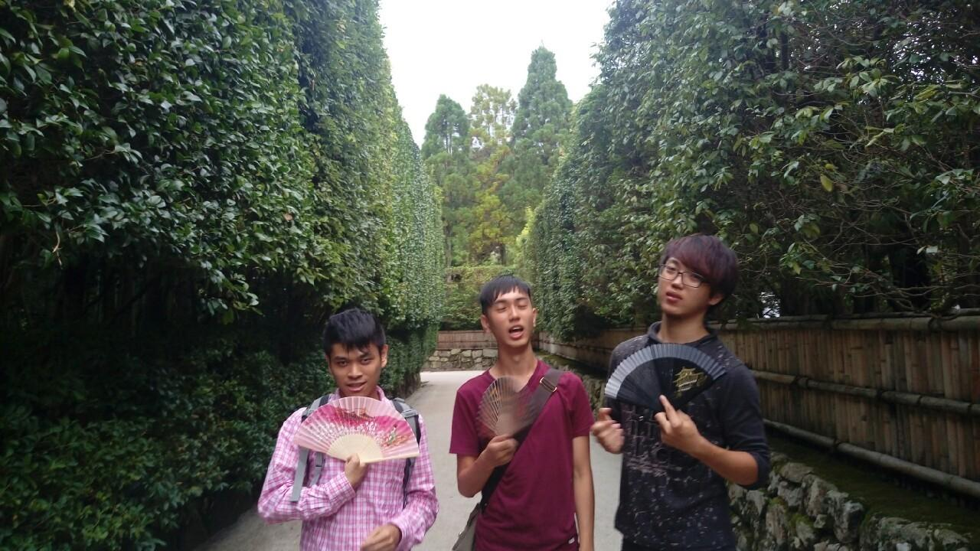

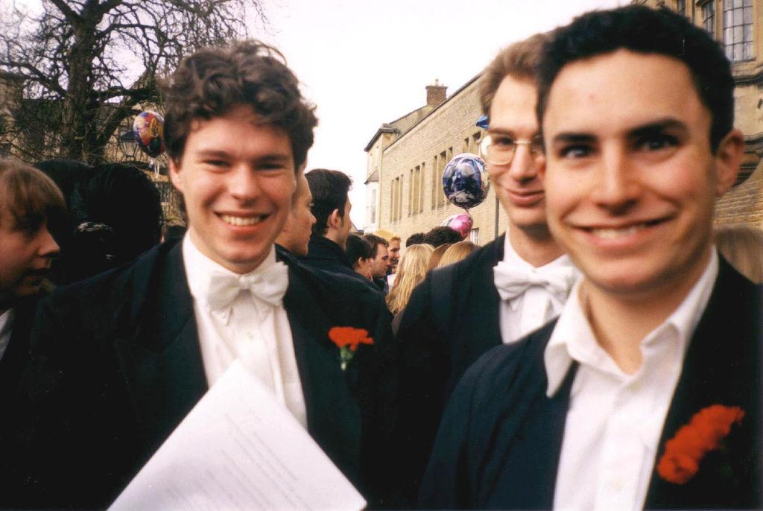
Goal
Simple, fast photo classification for mobile devices.

Slide 4
Method
SVM
+
low level feature
Building
Photo
Viola-Jones algorithm
+ The Fastest Pedestrian Detector in the West
People

Slide 5
Outline
Goal
In/Outdoor
Building
People
Evaluation
Demo

Slide 6
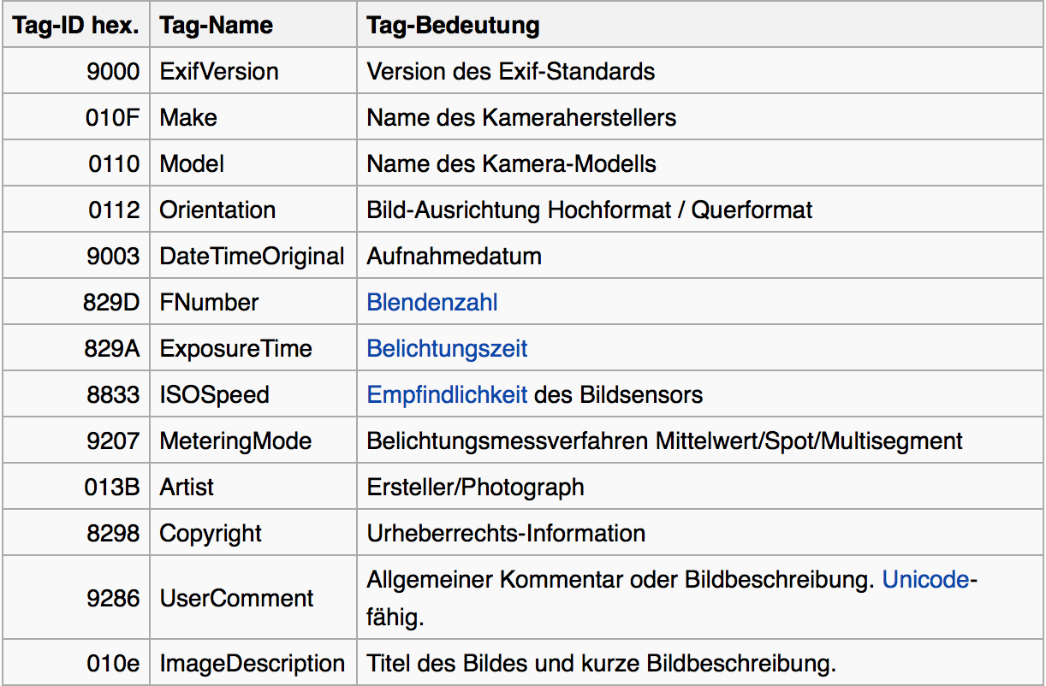
InOutDoor
Using EXIF information to detect
We extract following info as features ExposureTime
FNumber
ISOSpeedRatings
ShutterSpeedValue
ApertureValue
BrightnessValue
ExposureBiasValue
MaxApertureValue
FocalLength

Slide 7
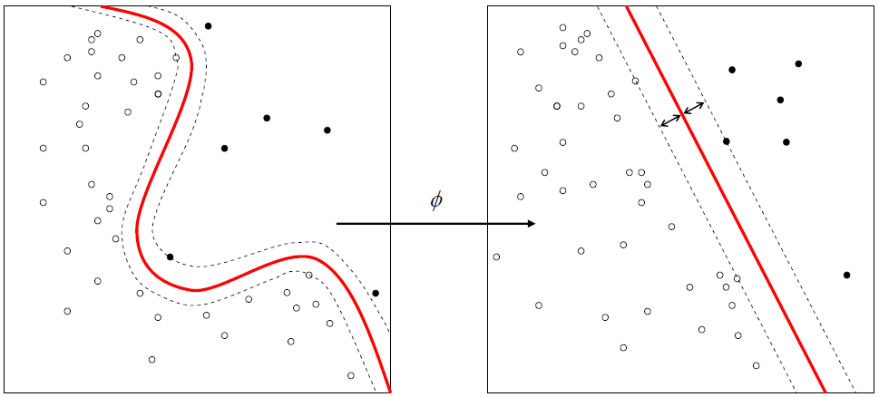
InOutDoor
By SVM (using rbf kernel) to train a model
Using model to predict the new one.
Training data set is too small

Slide 8
Outline
Goal
In/Outdoor
Building
People
Evaluation
Demo

Slide 9
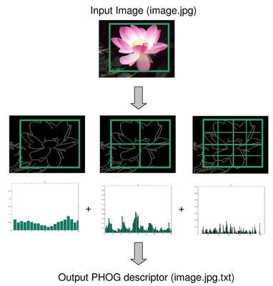
Building detection
Using PHOG to detect each pictures` edge orientation
Can pair with InOutDoor

Slide 10
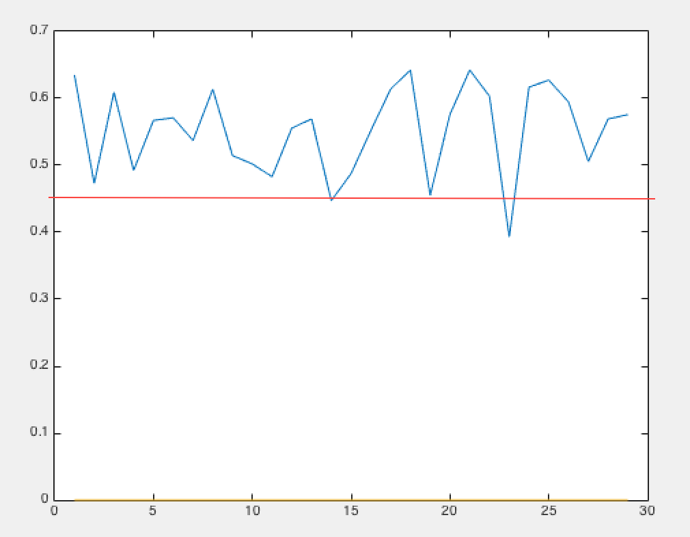
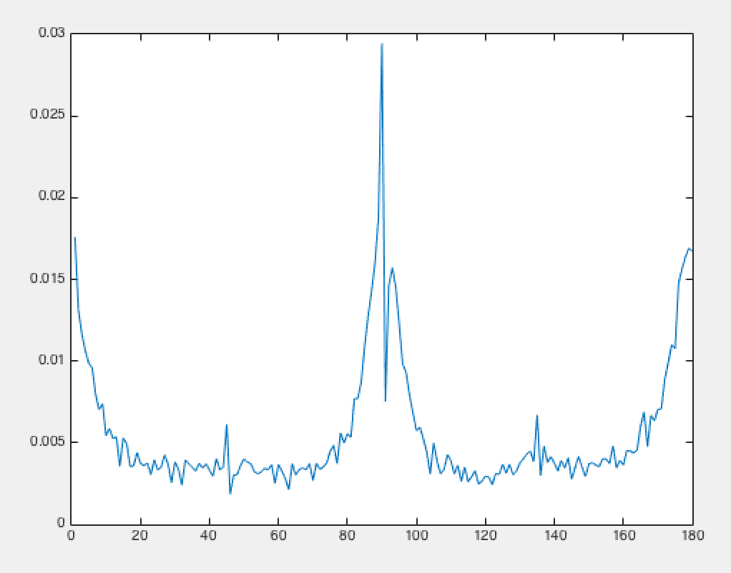
Observation
building`s orientation will have great proportion in 0~10 80~100 170~180
mean of Buildings` proportion over 45% mean of others` less than 45%
therefore we use 45% as threshold

Slide 11
The Problem We Face
Not all Building picture was taken in front
The one which have many Horizontal / vertical edge
The Building was blocked by other things, like people, tree, and so on
The fake one

Slide 12


The Problem We Face (Not taken in front)

Slide 13
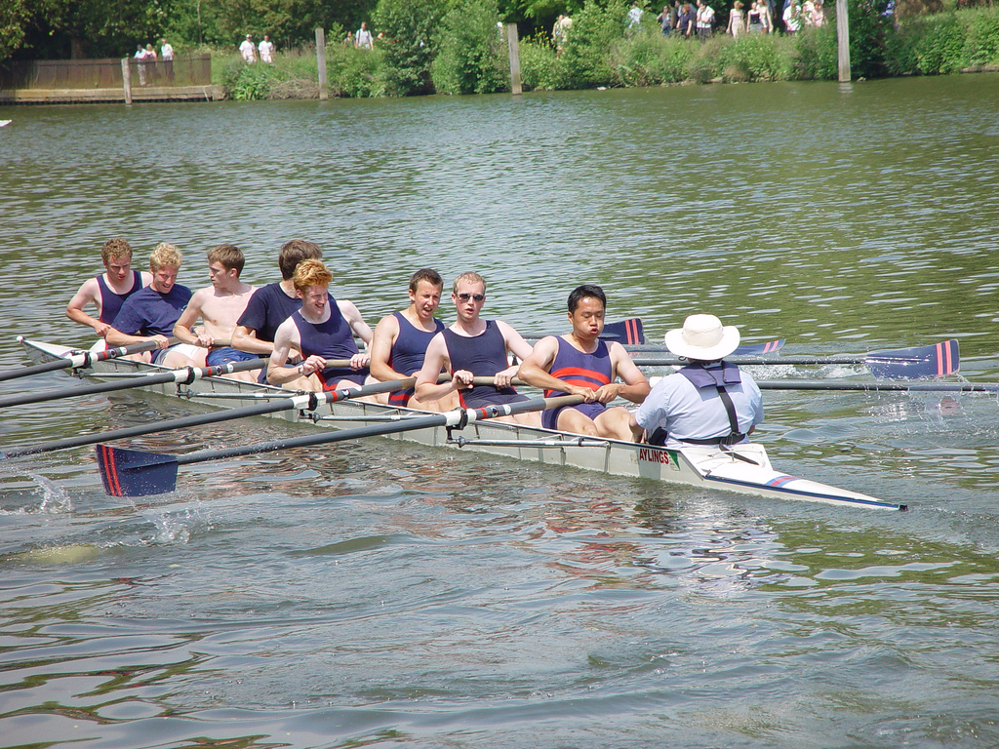
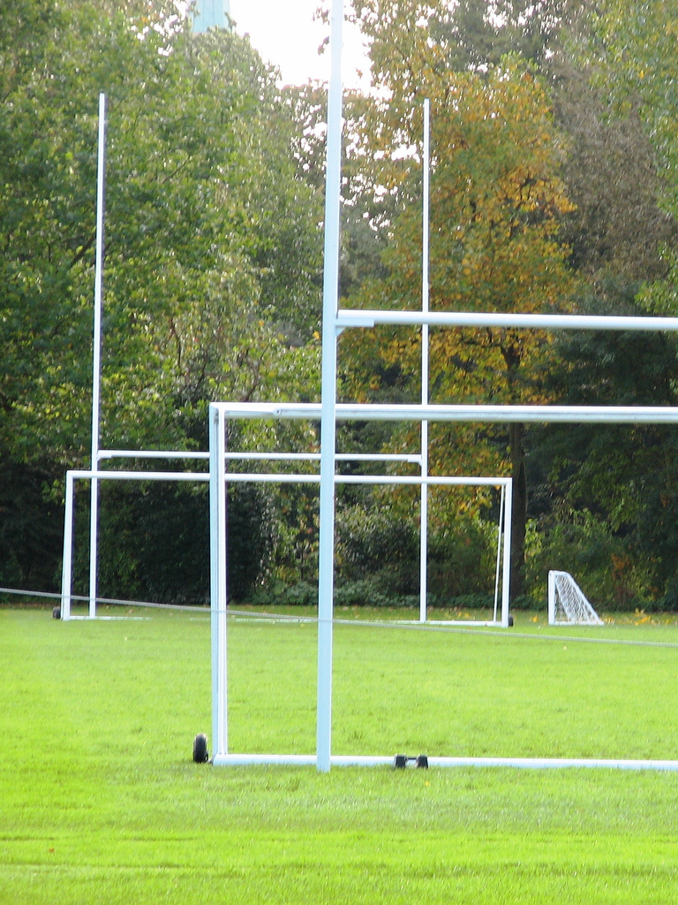

The Problem We Face (many Horizontal / vertical edge)

Slide 14


The Problem We Face (many Horizontal / vertical edge)

Slide 15
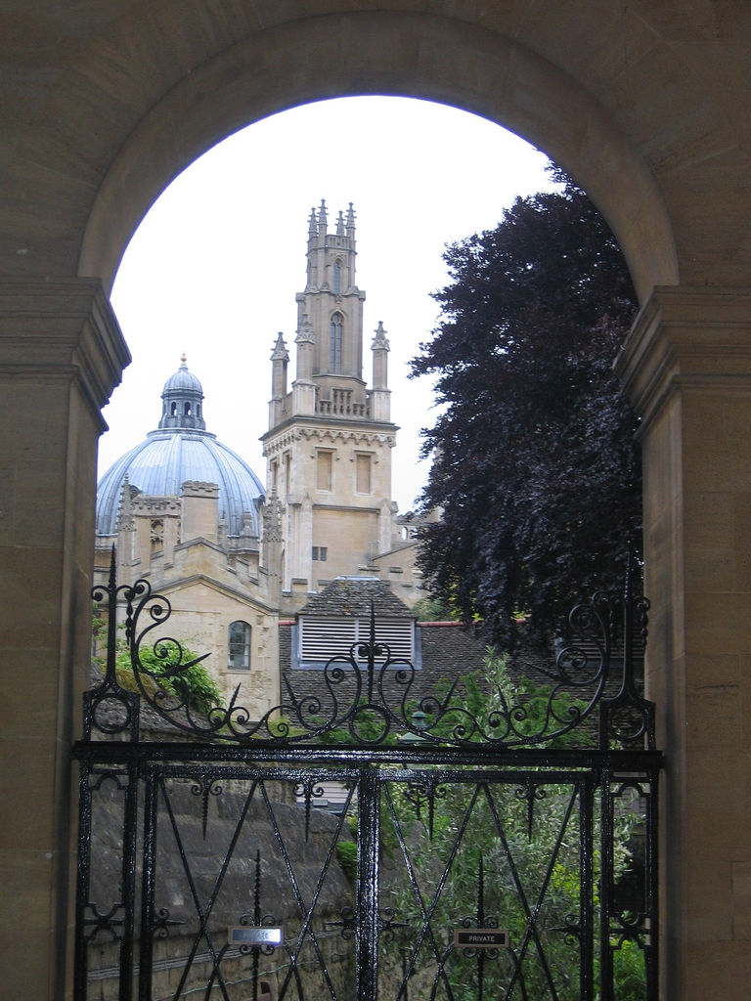
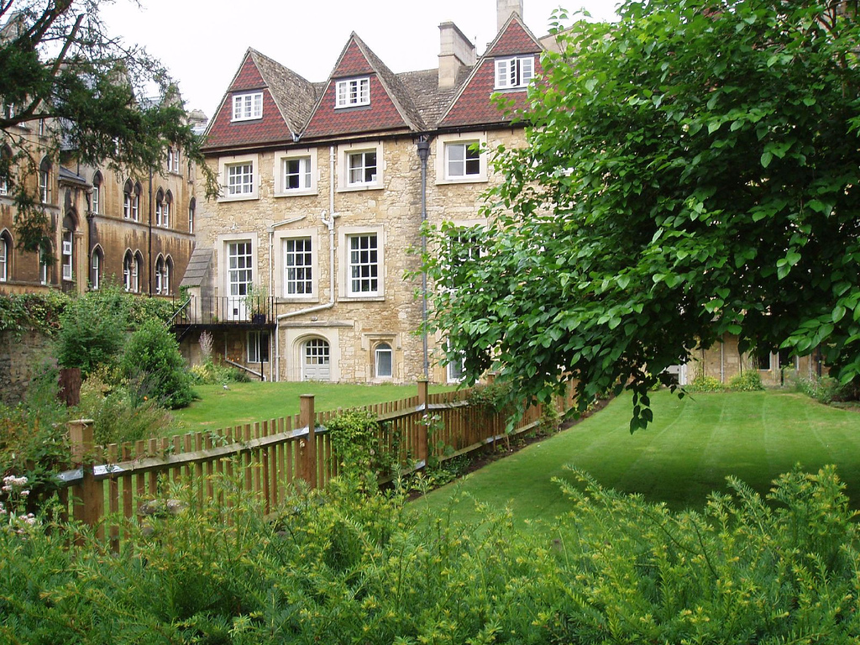
The Problem We Face (Blocked)

Slide 16
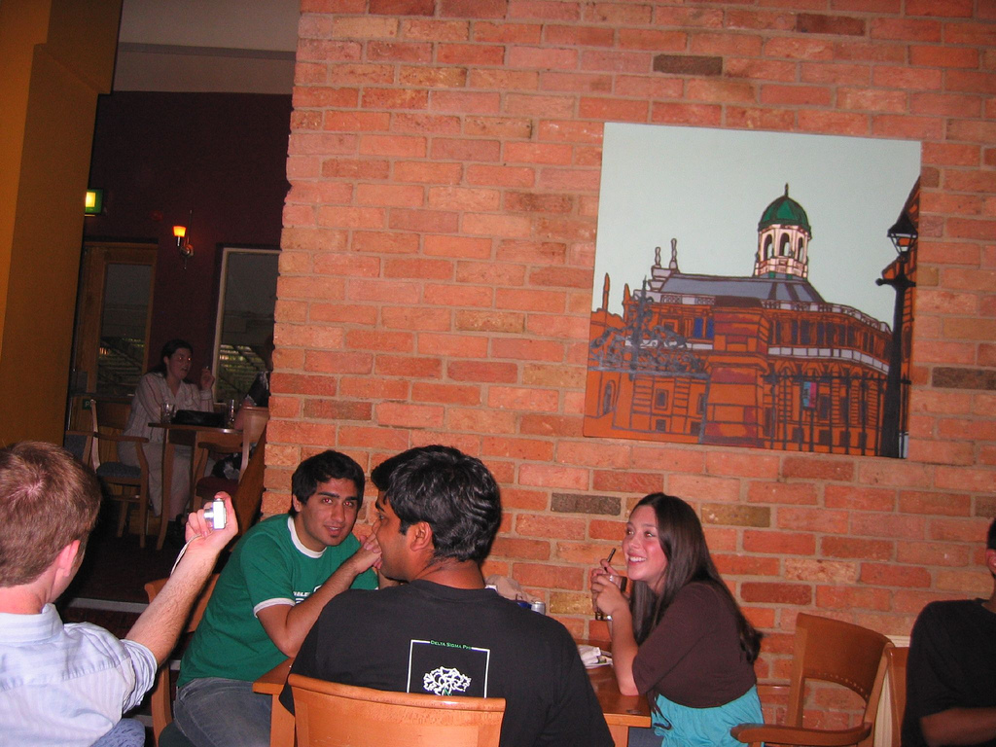
The Problem We Face (The Fake one)

Slide 17
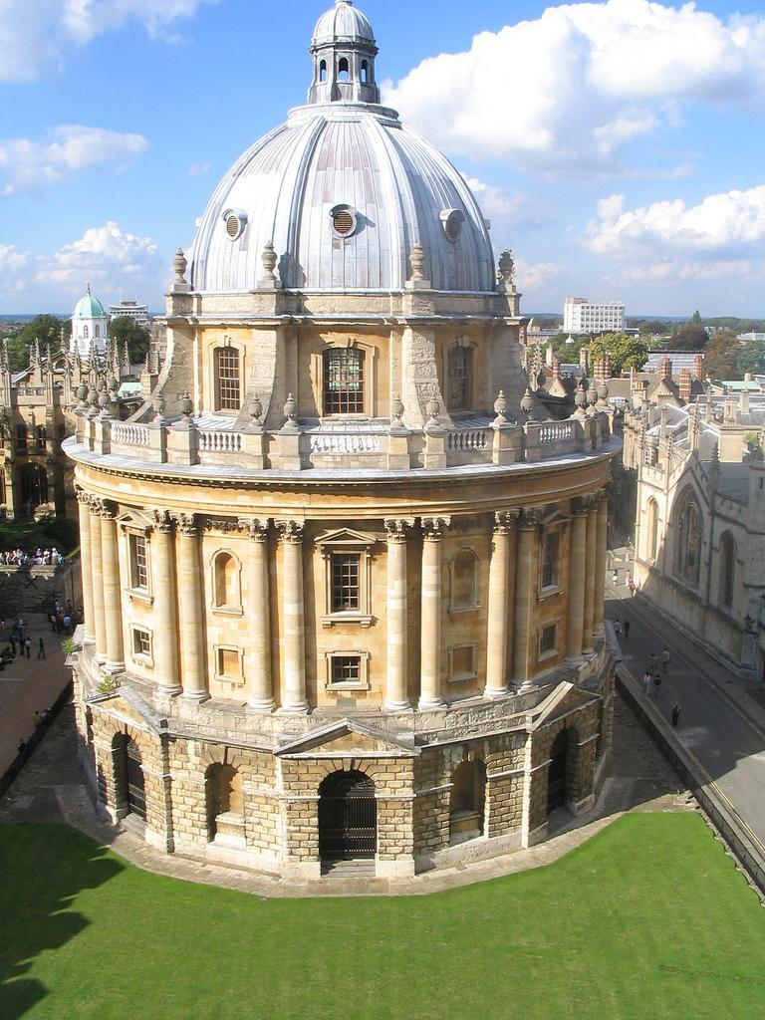
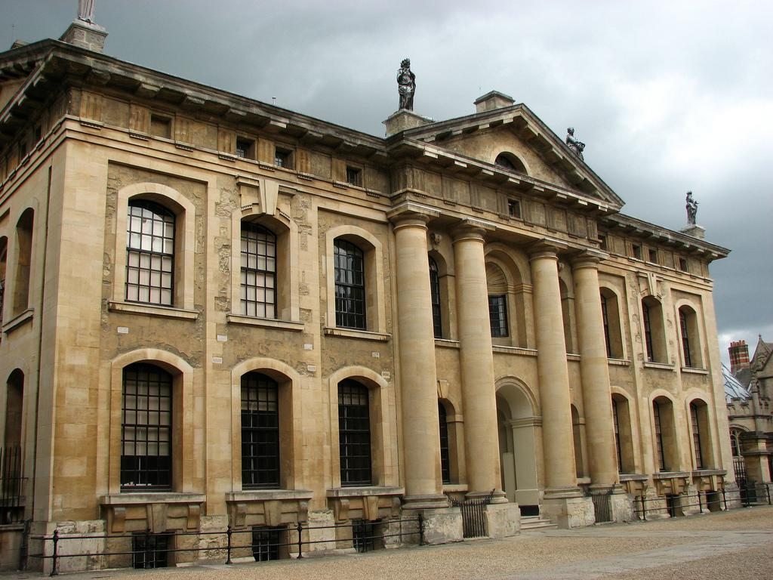
Good Result

Slide 18
Outline
Goal
In/Outdoor
Building
People
Evaluation
Demo

Slide 19
Findings
Set the threshold of the size of smallest detectable object to filter out some false detection
Pedestrian detection is too sensitive to the environment, even if the threshold is set

Slide 20
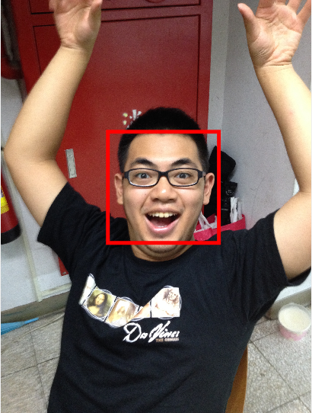
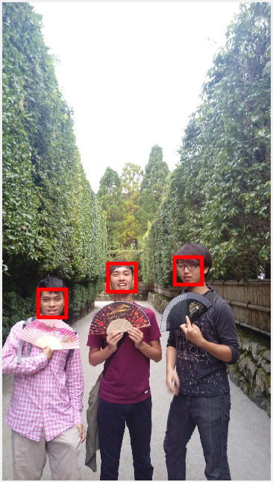
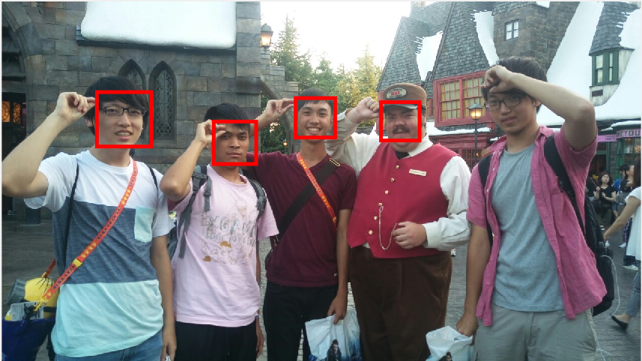
Viola-Jones algorithm

Slide 21
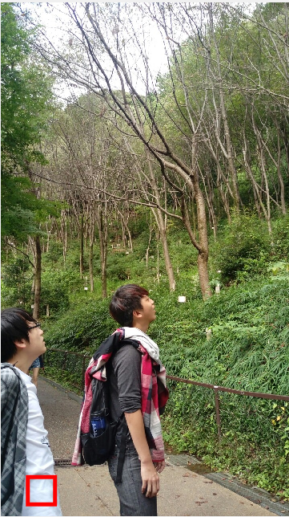
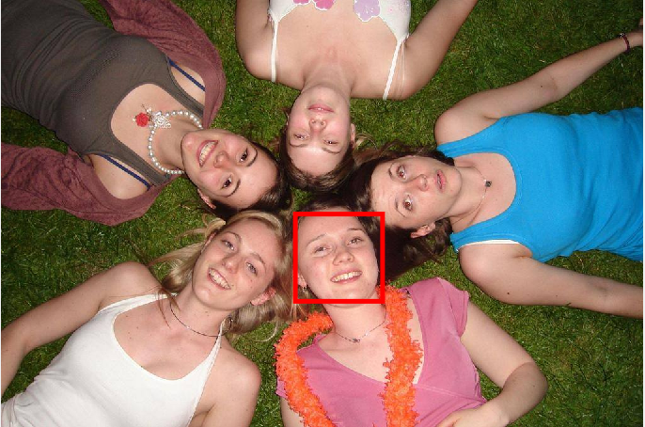

Slide 22
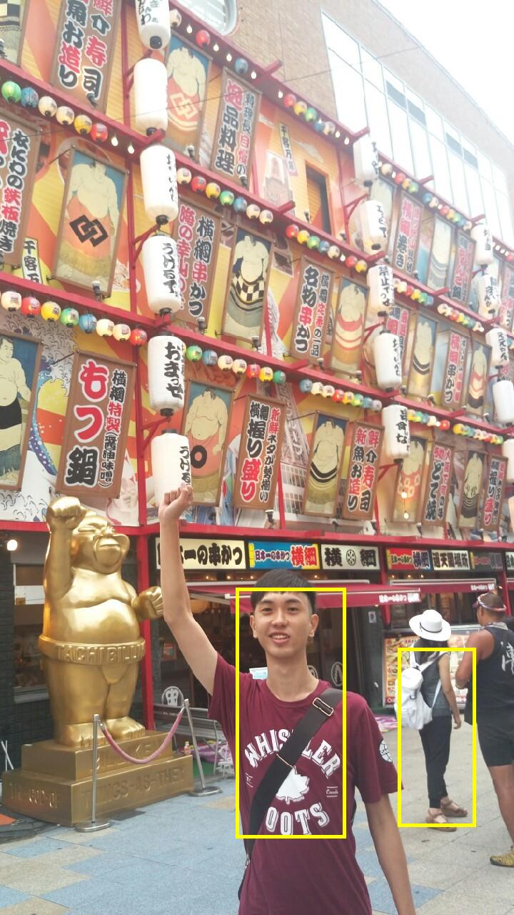
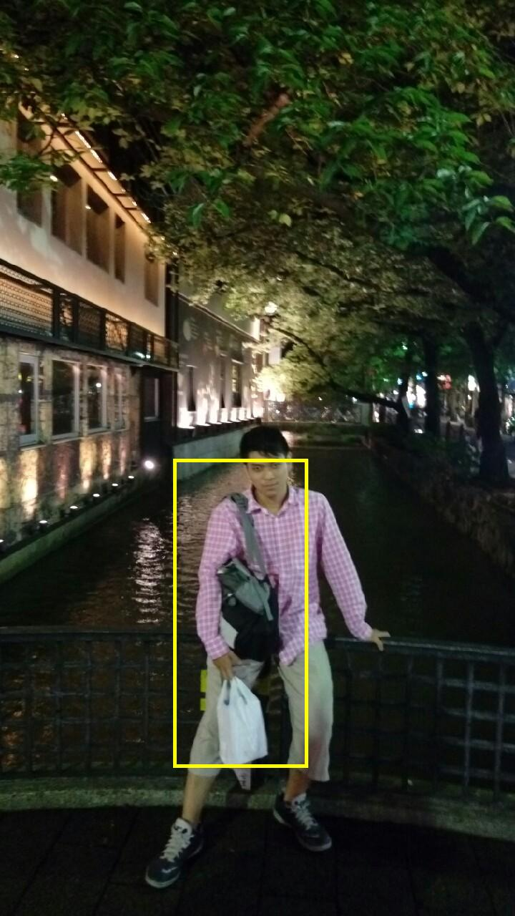
The Fastest Pedestrian Detector in the West

Slide 23
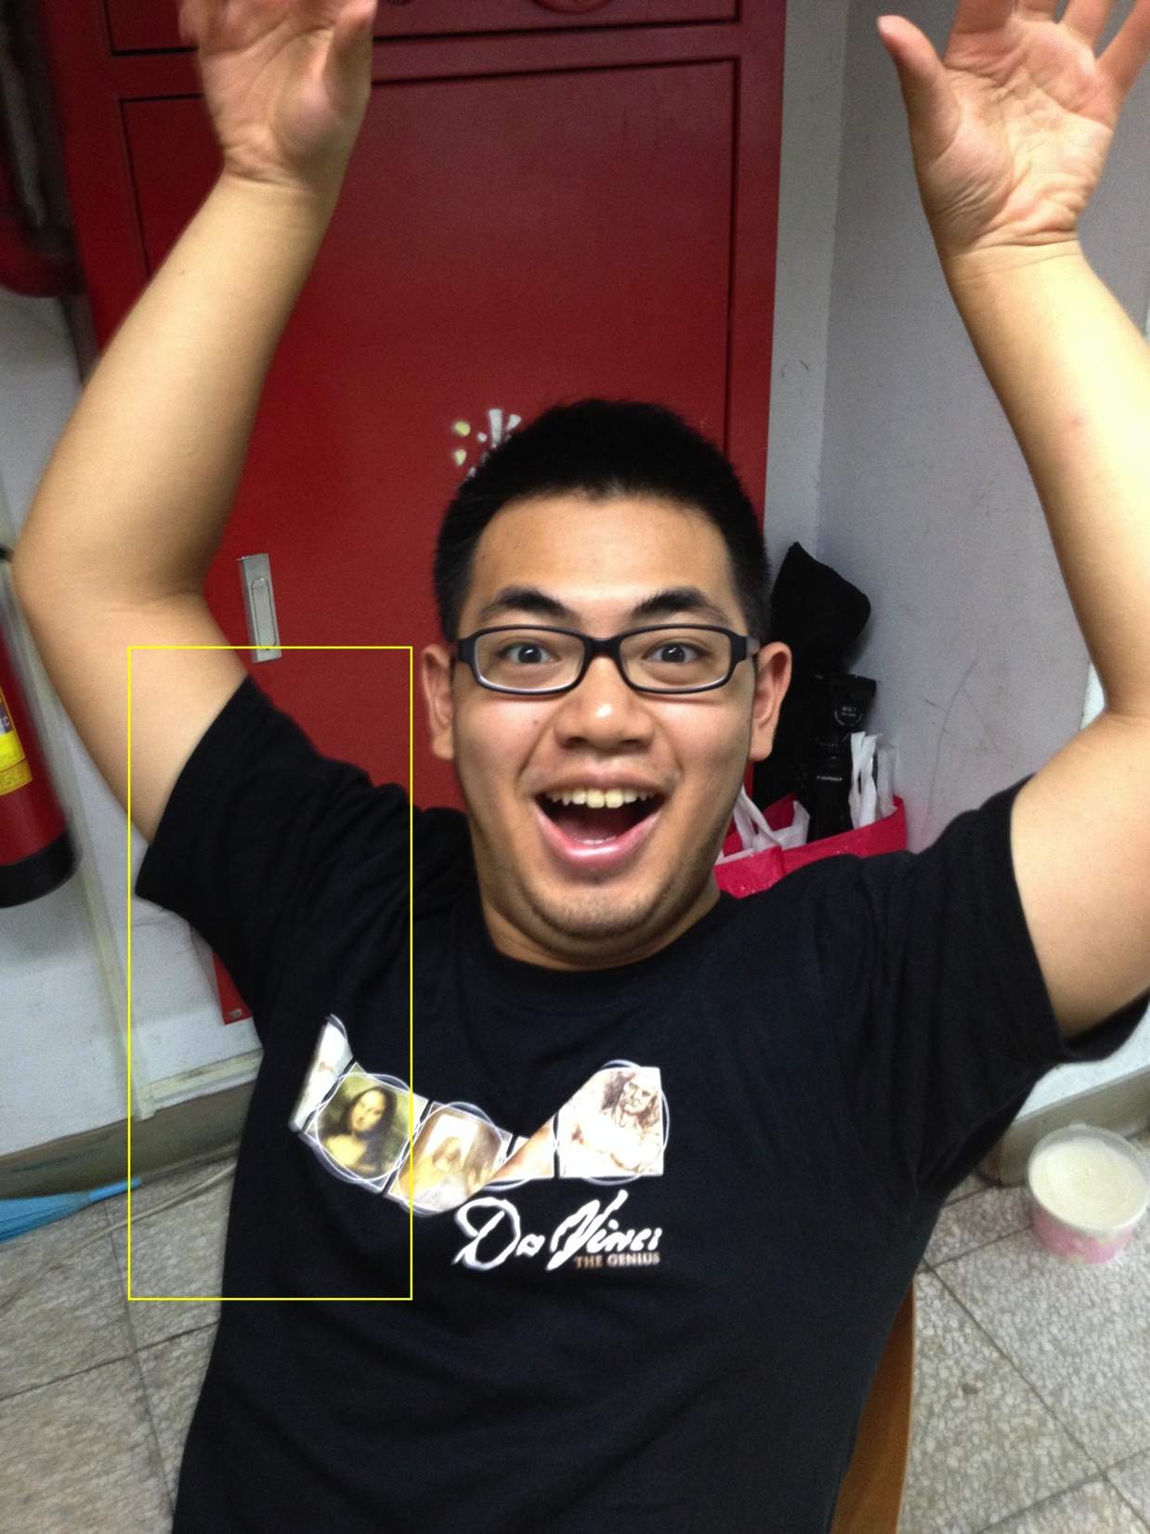
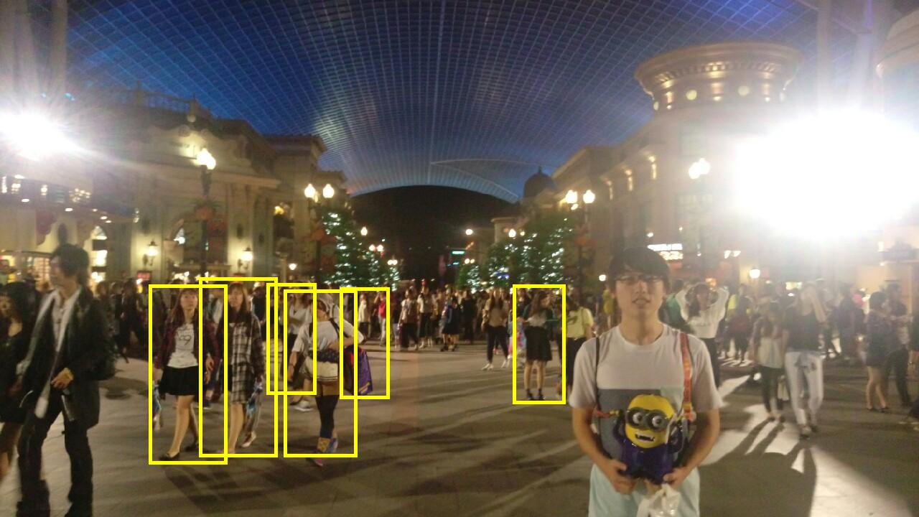
Bad Example

Slide 24
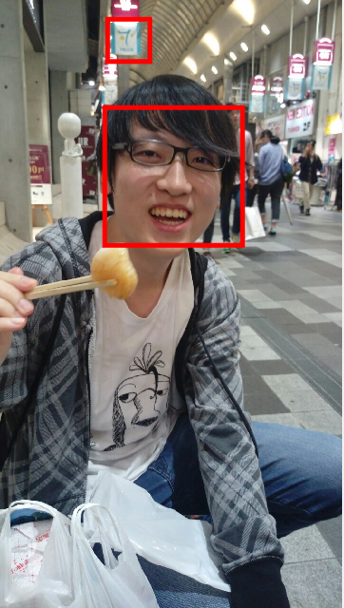

Compare two methods

Slide 25
Outline
Goal
In/Outdoor
Building
People
Evaluation
Demo

Slide 26
Evaluation (accuracy)
Building : 81.63 %
People : 65.15 %

Slide 27
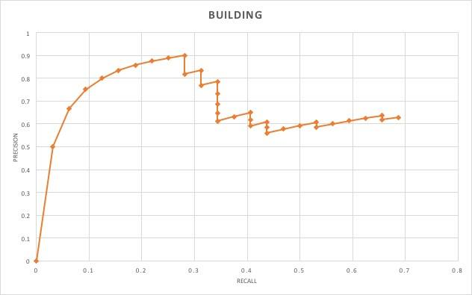
Evaluation(Building)

Slide 28
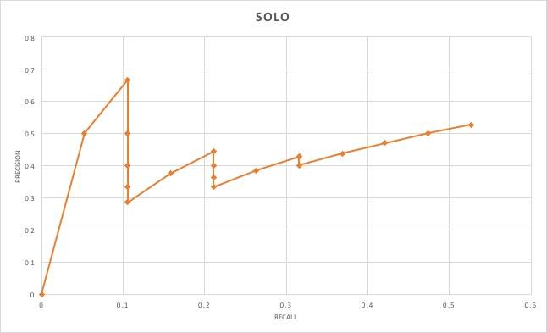
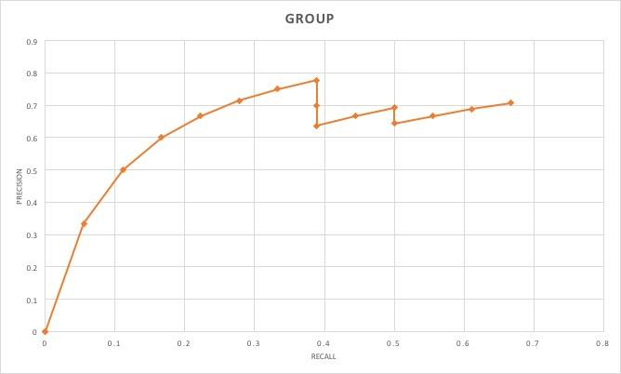
Evaluation(People)

Slide 29
Outline
Goal
In/Outdoor
Building
People
Evaluation
Demo

Slide 30
Ｑ＆Ａ

Slide 31
Thanks for listening

